Slide 1
Unit 2 Water Pollution
Water pollution Types of pollutants, effects- control measures, Water conservation and its methods, Rainwater harvesting, methods of rainwater harvesting, Surface runoff harvesting, Rooftop rainwater harvesting noise pollution effects and control measures, Thermal pollution, soil pollution nuclear hazard

Slide 2
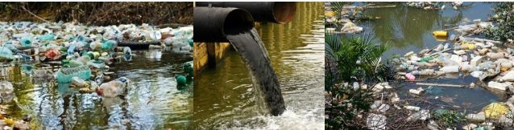
Water pollution
Water pollution is the contamination of water sources by substances which make the water unusable for drinking, cooking, cleaning, swimming, and other activities. Pollutants include chemicals, trash, bacteria etc.

Slide 3
Types Of Water Pollutants
1. Oxygen Demanding Waste
2. Disease-causing Agents
3. Synthetic Organic Compounds.
4. Plant Nutrients
5. Inorganic Chemicals And Minerals.
6. Sediments
7. Radioactive Substances
8. Thermal Discharge
9. Oil

Slide 4
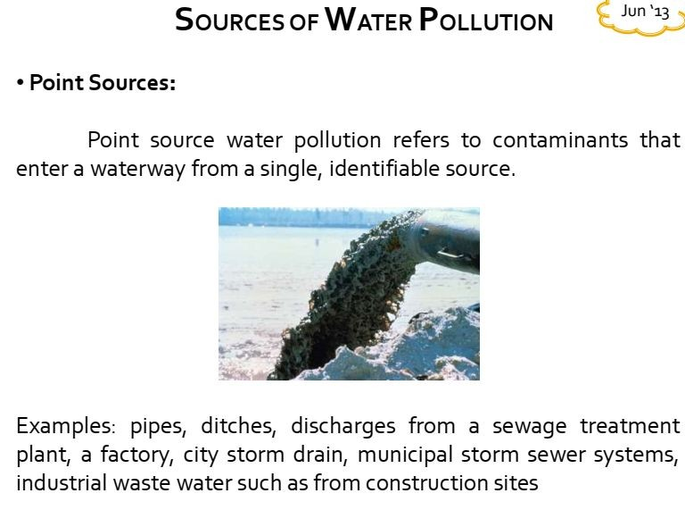

Slide 5
Non point sources
Non point-source pollution is the opposite of point-source pollution, with pollutants released in a wide area.
As an example, picture a city street during a thunderstorm. As rainwater flows over asphalt, it washes away drops of oil that leaked from car engines, particles of tire rubber, dog waste, and trash.
The runoff goes into a storm sewer and ends up in a nearby river. Runoff is a major cause of nonpoint-source pollution.

Slide 6
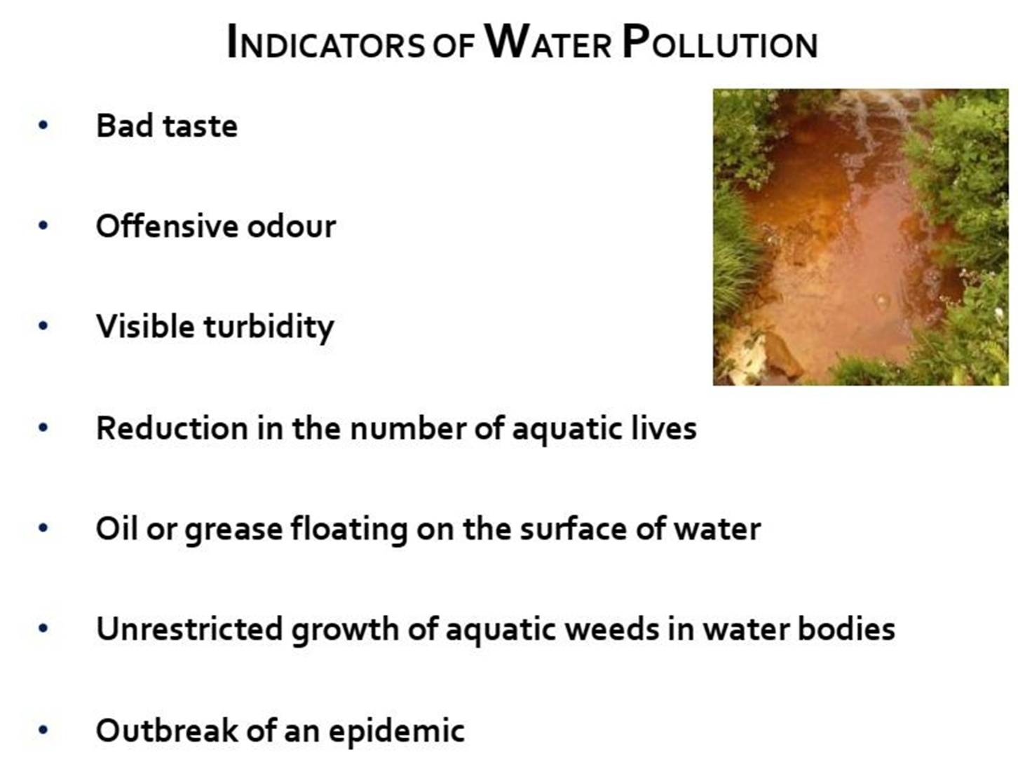

Slide 7
DISSOLVED OXYGEN
An important property of freshwater is dissolved oxygen (D0).
Lotic water such as fast flowing streams, usually contains higher level of DO than stagnant lentic water.
Dissolved oxygen is frequently measured as parts per millions.(ppm)
Areas with dissolved oxygen less than 0.2ppm are unable to support most life.
In lakes oxygen levels are usually lowest in deeper waters, except in the spring and fall overturns.

Slide 8
Chemical Oxygen Demand (COD)
Chemical Oxygen Demand (COD) is a test that measures the amount of oxygen required to chemically oxidize the organic material and inorganic nutrients, such as Ammonia or Nitrate, present in water.
COD is means of measuring all organic matter i.e biodegradable and non biodegradable.
COD tests results are higher than BOD tests .

Slide 9
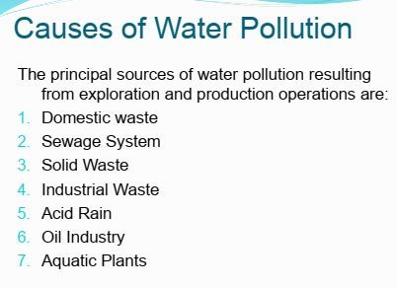

Slide 10
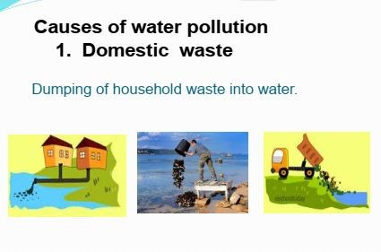
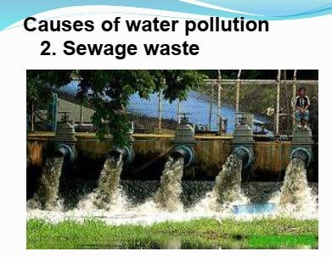

Slide 11
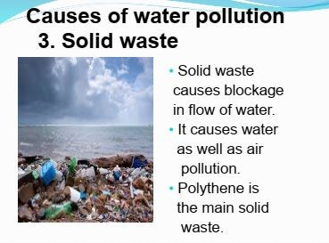
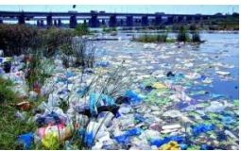
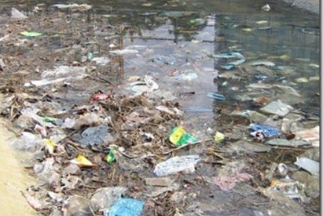

Slide 12
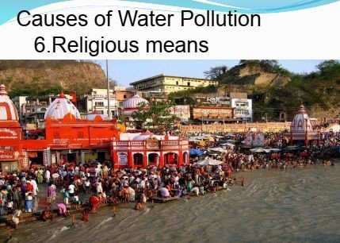
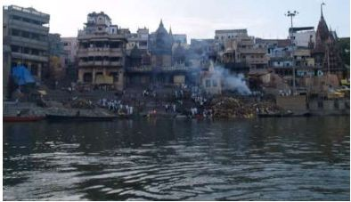
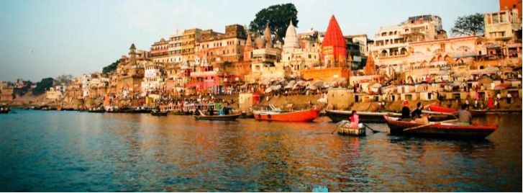

Slide 13
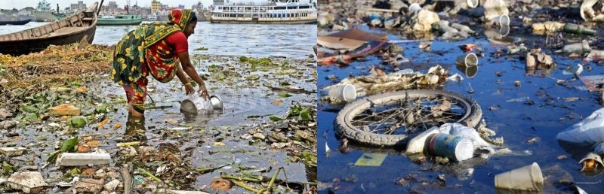
Effects Of Water Pollution
1. Highly polluted water bodies in the urban areas

Slide 14
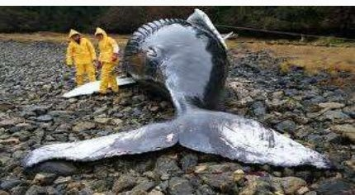
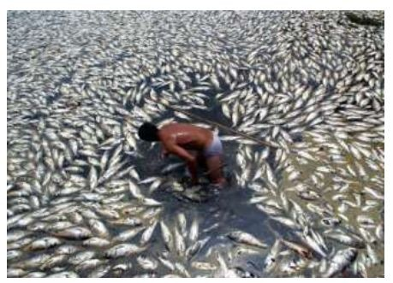
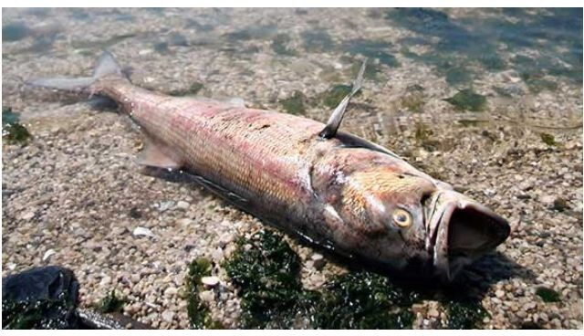
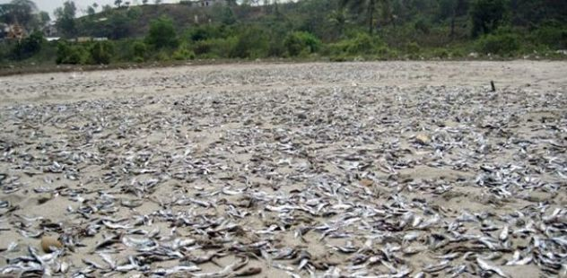
2. Death of aquatic organisms.

Slide 15
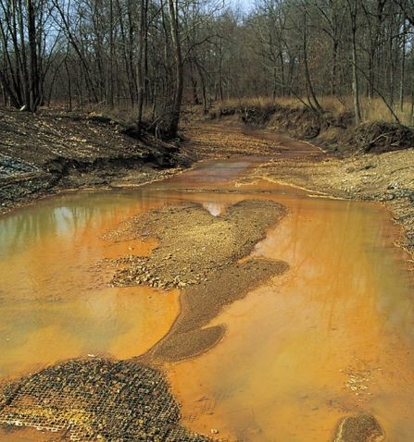
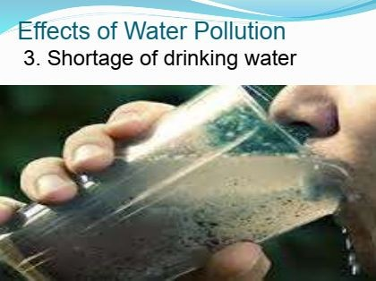

Slide 16
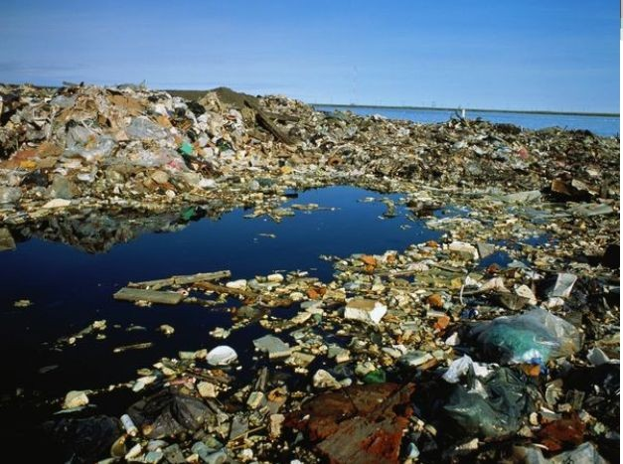
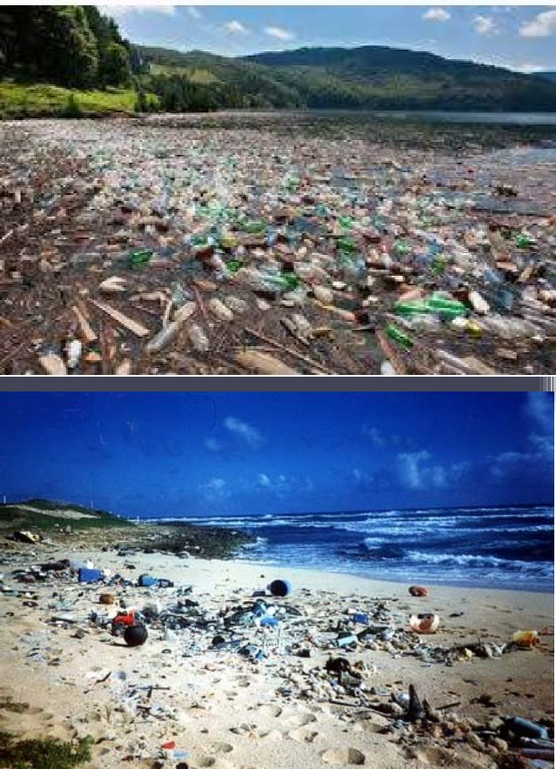
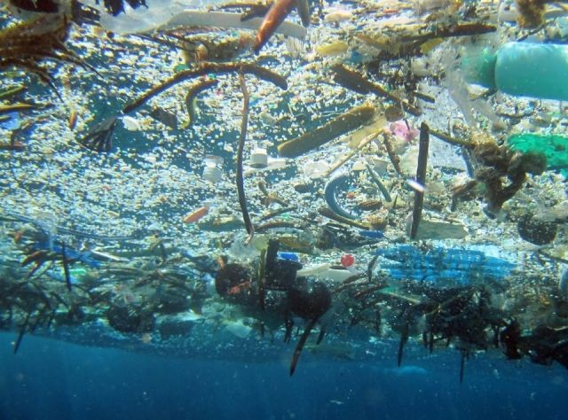
4. Marine and groundwater pollution

Slide 17
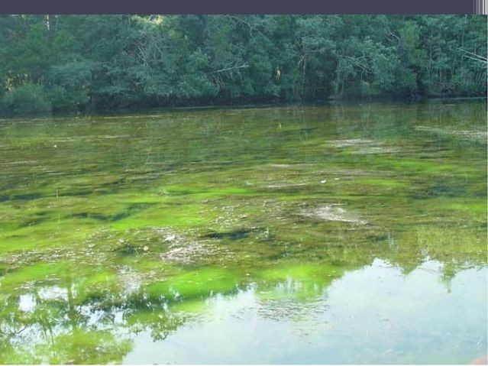
5. Eutrophication

Slide 18
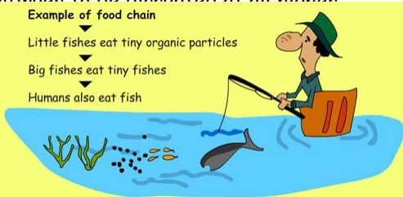
6. Depletion of food chain

Slide 19
7. DISEASES
If drinking water supplies cannot meet the demand, people will be forced to consume unsafe sources of drinking water.
Waterborne disease such as cholera, typhoid etc are prevalent in such locations, causing an untold number of deaths.

Slide 20
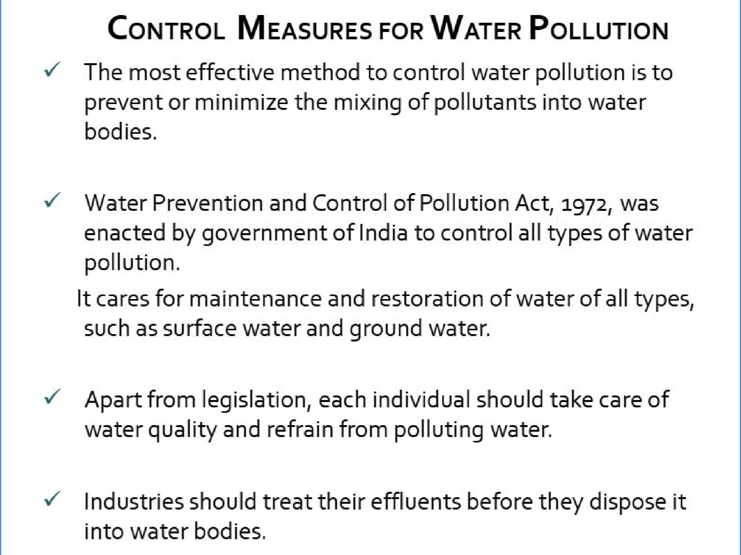

Slide 21
Water Conservation
Water conservation is the practice of using water efficiently to reduce unnecessary water usage. According to Fresh Water Watch, water conservation is important because fresh clean water is a limited resource, as well as a costly one.

Slide 22
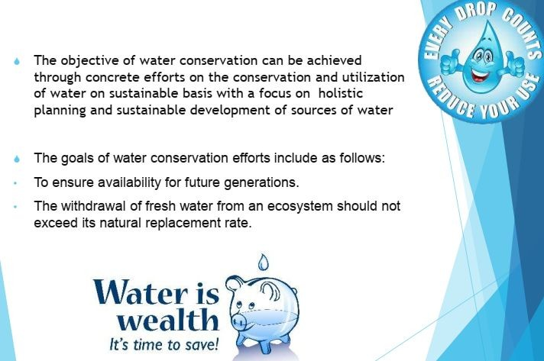

Slide 23
INDOOR WATER CONSERVATION
Take shorter showers.
Only run the washing machine for full loads.
Turn off the faucet while brushing your teeth or shaving.
Don’t wash dishes under continue running water.
Check faucets and pipes for leaks.
Monitor your water bill for unusually high use. Your bill and water meter are tools that can help save water.
Use low-flush toilets.

Slide 24
OUTDOOR CONSERVATION OF WATER
Adjust your sprinklers so that they are watering your lawn and garden.
Water early in the morning or later in evening.
Install drip irrigation.
Water your lawn only when it needs.
Check your irrigation systems if broken.

Slide 25
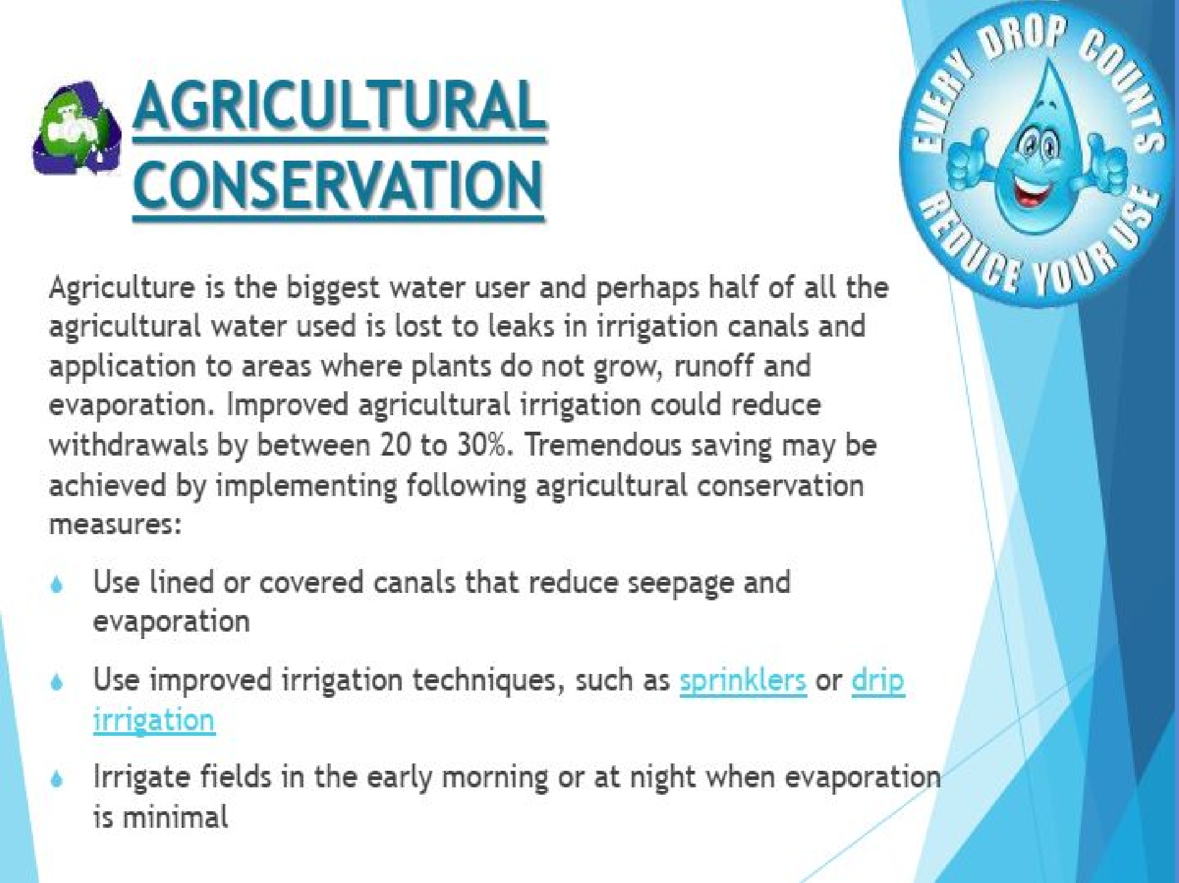

Slide 26
Benefits Of Water Conservation
Protects water supplies.
Reduces water purchase costs.
Reduces energy use (associated with water extraction, conveyance, treatment, and distribution).
Protects ecosystems.

Slide 27
Characteristics of Water
Physical Characteristics of Water
Temperature
Colour
Turbidity
Taste and odour
Specific conductivity.

Slide 28
Chemical Characteristics of Water
Total Solids and Suspended Solids.
Hardness
Chlorides
pH value of Water
Nitrogen Content.
Dissolved oxygen
Biological Oxygen Demand (BOD)
Iron and manganese
Lead

Slide 29
Biological Characteristics
Total count test
B.coil test
Membrane filter test

Slide 30
Water Harvesting
Water harvesting is the activity of direct collection of rainwater. The rainwater collected can be stored for direct use or can be recharged into the groundwater. Rain is the first form of water that we know in the hydrological cycle, hence is a primary source of water for us. Rivers, lakes and groundwater are all secondary sources of water. In present times, we depend entirely on such secondary sources of water. In the process, it is forgotten that rain is the ultimate source that feeds all these secondary sources and remain ignorant.

Slide 31
Rain Water Harvesting
Rainwater harvesting (RWH) is the technique used for collection and storage of rain, rather than allowing it to run off.
Rainwater is collected from a roof-like surface and redirected to a tank, deep pit (well, shaft, or borehole), aquifer, or a reservoir, so that it seeps down and restores the ground water.
The water collected through rain water harvesting can be filtered, stored and used for various purposes.

Slide 32
Methods of rain water harvesting
Surface Runoff Harvesting
2. Rooftop Rainwater Harvesting

Slide 33
1.Surface Runoff Harvesting
In urban areas, rainwater flows away as surface runoff. This runoff can be caught and used for recharging aquifers by adopting appropriate methods.
Surface runoff rainwater harvesting is a method of collecting rainwater flowing along the ground during the rains will be collected to a tank below the surface of the ground for irrigation and other purpose.
The main objective of surface runoff rainwater harvesting method is to meet the ever increasing demand of water, to reduce soil erosion and flooding of roads.

Slide 34
2.Rooftop Rainwater Harvesting
It is a system of catching rainwater where it falls. In rooftop harvesting, the roof becomes the catchment, and the rainwater is collected from the roof of the house/building.
Harvested rain water can either be stored in a tank or diverted to an artificial recharge system to meet the household /commercial needs through storage in tanks.
This method is simple, eco-friendly, less expensive and truly effective.
The main objective of rooftop rain water harvesting is to make water available for future use, to improve quality of ground water.

Slide 35
Components of the Rooftop Rainwater Harvesting
Catchment
Transportation
First Flush
Filter

Slide 36
Advantages of Rainwater Harvesting
Less cost.
Helps in reducing the water bill.
Decreases the demand for water.
Promotes both water and energy conservation.
Improves the quality and quantity of groundwater.
This technology is relatively simple, easy to install and operate.
It reduces soil erosion, runoff, flooding, and pollution of surface water with fertilizers, pesticides, metals and other sediments.
It is an excellent source of water for landscape irrigation with no chemicals, dissolved salts and free from all minerals.

Slide 37
Disadvantages of Rainwater Harvesting
Regular maintenance is required.
Requires some technical skills for installation.
If not installed correctly, it may attract mosquitoes and other waterborne diseases.
The water that is received by rain water harvesting may not be suitable for drinking unless treated properly.

Slide 38
Noise Pollution
Sound that is unwanted or disrupts one’s quality of life is called as noise. When there is lot of noise in the environment it is termed as noise pollution.
Sound becomes undesirable when it disturbs the normal activities such as working, sleeping, and during conversations.
The word noise is derived from the Latin word ‘Nausea’.
The intensity of sound is measured in decibels (dB).

Slide 39
Source of Noise Pollution
Transportation Noise
Industrial Noise
Construction of building, highways and streets
Road Traffic Noise
Noise from Aircraft
Noise from Industrial Activity
Fireworks
Household sources
Social events

Slide 40
Construction Noise
The noise from the construction of highways, city streets, and buildings is a major contributor to the noise and air pollution in cities. For example, construction noise sources include:
Air Hammers
Air compressors
Bulldozers
Loaders and
Dump trucks

Slide 41
Fireworks:
Indian festivals like Diwali, marriages, etc. use fireworks during celebrations.
However, bursting firecrackers is a health hazard since it is responsible for both air pollution and noise pollution. The noise created is hazardous, can lead sometimes to non-recoverable hearing loss.
Household sources:
Gadgets like food mixers, grinder, vacuum cleaner, washing machine etc can be very noisy and injurious to health.
Other include loud speakers of sound systems and TVs
Another example nay be your neighbour’s dog barking all night everyday disturbing everyone else in the apartment.

Slide 42
Causes and Sources of Noise Pollution
Following are the causes and sources of noise pollution:
Industrialisation: Industrialisation has led to an increase in noise pollution as the use of heavy machinery such as generators, mills, huge exhaust fans are used, resulting in the production of unwanted noise.
Vehicles: Increased number of vehicles on the roads are the second reason for noise pollution.
Events: Weddings, public gatherings involve loudspeakers to play music resulting in the production of unwanted noise in the neighbourhood.
Construction sites: Mining, construction of buildings, etc add to the noise pollution.

Slide 43
Effects of Noise Pollution on Human Health
Noise pollution can be hazardous to human health in the following ways:
Hypertension: It is a direct result of noise pollution which is caused due to elevated blood levels for a longer duration.
Hearing loss: Constant exposure of human ears to loud noise that are beyond the range of sound that human ears can withstand damages the eardrums, resulting in loss of hearing.
Sleeping Disorders: Lack of sleep might result in fatigue and low energy level throughout the day affecting everyday activities. Noise pollution hampers the sleep cycles leading to irritation and an uncomfortable state of mind.
Cardiovascular issues: Heart-related problems such as blood pressure level, stress and cardiovascular diseases might come up in a normal person and a person suffering from any of these diseases might feel a sudden shoot up in the level.

Slide 44
Lack of concentration:
Noise causes lack of concentration. In big cities, mostly all the offices are on main road. The noise of traffic or the loud speakers of different types of horns divert the attention of the people working in offices.
It causes heart attack:
Noise pollution causes increase in the rate of heart-beat, increased cholesterol level which leads to blood pressure that resulted in heart attack.

Slide 45
Control Measures To Reduce Noise Pollution
Maintain distance between industrial area, bus terminals, railway stations etc from the residential area.
Controlling human activities like minimum use of loudspeakers.
Workers which are working on sites should use ear plugs for hearing protection.
Factories and industries should be placed away from residential areas.
Use of loudspeakers with 500m of hospitals, educational institutes are strictly banned.
Fireworks having large noise capacity should not be used.

Slide 46
Maintenance of vehicles should be done regularly to reduce noise pollution.
Social awareness programs are needed to be arranged for educating public about the cause and effects of noise pollution.
Sound proof doors and windows are needed to be placed to block unwanted noise.

Slide 47
Thermal Pollution
Thermal pollution occurs when hot or cold water is dumped into a natural body of water, changing its temperature.
Thermal pollution is any sudden change in the temperature of a natural body of water. Normally rivers, lakes, and oceans maintain a fairly steady temperature. They gain heat from sunlight, warm currents, and hot springs, but they disperse this heat naturally.
However, when a large amount of hot or cold water gets dumped in, this overwhelms the natural balance. The water temperature shifts, throwing the ecosystem into disarray. Thermal pollution alters the water chemistry and harms plants and animals, causing stress, disease, and even death.

Slide 48
Causes of thermal pollution
Nuclear power plant
Industrial effluent
Domestic sewage
Hydro-electric power
Soil erosion
Deforestation

Slide 49
Effects Of Thermal Pollution
Disruption of fish and amphibian habitats
Decrease in dissolved oxygen
Increased toxins in the water
Detrimental impact to biodiversity

Slide 50
Soil Pollution
Soil pollution refers to the contamination of soil with concentrations of toxic substances.
soil contamination can occur because of human activities or because of natural processes. However, mostly it is due to human activities. It occurs due to many different activities such as overuse of pesticides the soil will lose its fertility and the presence of excess chemicals will increase the acidity or alkalinity of soil and hence degrading the quality of the soil.

Slide 51
Types of Soil ​Pollution
Agriculture soil pollution is caused due to the excessive use of pesticides and insecticides.
Soil Pollution by industrial discharges of chemicals from mining and manufacturing of goods.
Solid waste soil pollution/ Poor management or inefficient disposal of waste.
Soil Pollution due to urban activities. etc

Slide 52
Soil Pollution Causes
Industrial Pollution
Agricultural Activities
Waste Disposal
Acid Rain
Heavy Metals
Oil Spills
Nuclear Waste

